Slide 1

Is Big Mountain optimally capitalized?

Slide 2
Background
Pricing strategy has been to charge a premium above the average price of resorts in its market segment
This approach does not provide a good sense of important some facilities are
Big Mountain is potentially not capitalizing on its facilities as much as it could
Big Mountain recently installed an additional chair lift that increases their operating costs by $1.5 million this season
What facilities justify higher ticket prices and which facilities can be scrapped or downgraded without undermining the current ticket price? How much can we increase ticket price with this new chair lift?

Slide 3
Key Findings
Big Mountain is currently under capitalized by at least $5 and at most $20 for a median price suggestion of $96 per Adult weekend tickets. A new chair on its own would support a 29-cent increase in ticket price generating a $500K over the season while the operating costs of the chair are 1.5 million, an .87 cost per person.
Adding a run 150 feet lower than our BM’s lowest point and adding a chair lift supports a $2 ticket price increase with a $3.5 million expected revenue increase. This is the highest of all four proposed plans. Adding 2 acres of snow area neight increases or decreased supported ticket price.

Slide 4
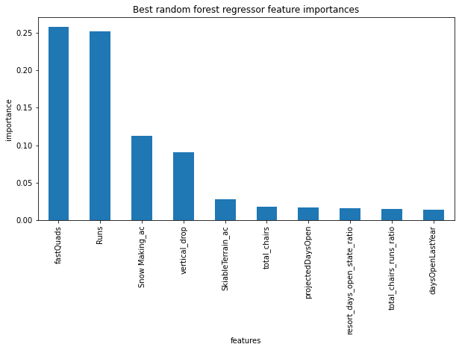
Model analysis and results
Big Mountain’s suggested Adult Weekend Ticket Price is $96 , give or take $10 – the mean absolute error of the model
This model has half the error of guessing the average price of other resorts from the same data set (~ $19)
The model found the following features to be of important to gauging ticket price.
FastQuads, Runs, Snow_Making_ac, vertical _drop

Slide 5
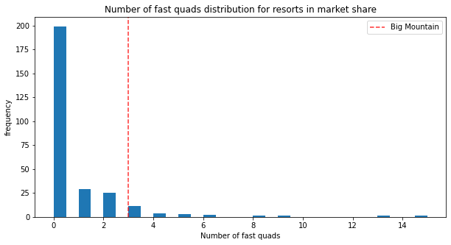
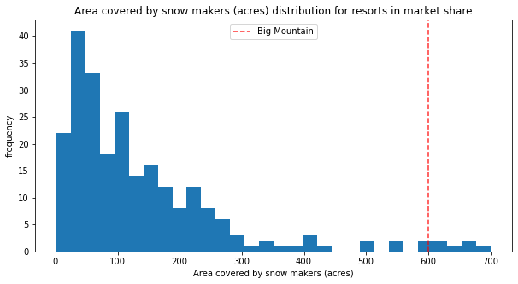
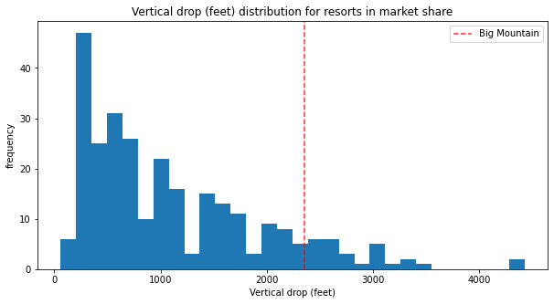
High value in areas where BM excels
Model found high value in FastQudas, Snow_Making_ac, total runs, and vertical drops, where BM is ahead

Slide 6
Summary and conclusion
Big Mountain’s pricing model as it stands, in the most conservative of estimate is leaving $8.75 million in yearly revenue on the table.
Installing another chair on its own would take 3 years to pay off given the supported price.
Given the operating costs of different features together with the results of the model, an optimal set of facility changes given time and budget constraints should be possible using a linear program
The model could serve as the basis for an interactive tool used by business leaders and analysts, to compare different combinations of changes for the revenue of black mountain against one another at their leisure

